Slide 1
Movie Complexity and Ratings
Roshan Jha

Slide 2
Abstract
IMDB Movie Dataset. Our research question is What types of movies genres user viewed and rated most than other movies genres ? We take some general approach to solve it. We successfully find the relationship between genres and ratings value including average ratings value with concern launch year.

Slide 3
Motivation
We want find the most rated genres in the given movies data set. Our goal is to find what types of movies user like most and rated most as well. We have to merge two data set for this purpose and doing some operation on it to get the desire result. If we’re asked what genres people like most and vote them as well. Here we try to give the answer.

Slide 4
Dataset(s)
This dataset (ml-25m) describes 5-star rating and free-text tagging activity from MovieLens, a movie recommendation service. It contains 25000095 ratings and 1093360 tag applications across 62423 movies. These data were created by 162541 users between January 09, 1995 and November 21, 2019. This dataset was generated on November 21, 2019.
Users were selected at random for inclusion. All selected users had rated at least 20 movies. No demographic information is included. Each user is represented by an id, and no other information is provided.
The data are contained in the files genome-scores.csv, genome-tags.csv, links.csv, movies.csv, ratings.csv and tags.csv.
For our mini-project we will be using the below 2 datasets:
1. movies.csv
2. ratings.csv
For more information about this dataset, please visit: http://files.grouplens.org/datasets/movielens/ml-25m-README.html
This and other GroupLens data sets are publicly available for download at http://grouplens.org/datasets/.

Slide 5
Research Question
What types of movies genres user viewed and rated most than other movies genres ?

Slide 6
Data Preparation and Cleaning
We are fully concern on preparing and cleaning our data after acquiring it from the source. Before we start further operation like statistical or merge or plot or something like that we know we have to prepare our data first. Real time data are often corrupted with unexpected value or null value, to get rid of these problem we need to operate some data cleaning operation. We look through first is there any null value , if so drop those rows containing null values. This is how we prepare our data set , most like cleaning the corrupted data or missing data. We took two data frame for our operation and clean it well. In movies data set , we have title and genres columns , from their we need to extract the launching year for each movies and create a new column name year and after that we delete the title column as it’s then not necessary any more. Then taking average ratings from ratings data frame we merge the both data set and group them by with movie Id. We again then clean the new created data set and make sure there is no null or missing value in our data set.

Slide 7
Methods
For our data analysis we use mostly pandas module also matplotlib module for ploting purposes. The research question that we want to find answer lead us to use some of most effective function in pandas. The methods is a general approach nothing rocket science but effective enough to give the answer of our research question. We created a new data set from movies and ratings data set , where we get some essential columns such as ‘MovieId’ , ‘Title’ , ‘Genres’ , ‘Ratings’ … Now , from Title column , we extract the value of Launching year of each movies and made a New column name as ‘Year’ . We did it we can visualize the co-relation of ratings values of movies with its launching year. We compared between ratings and genres , and see a significant result. Among of all genres , ‘Drama’ has the height in number , so we found a general idea that Drama movies are rated mostly. We plot pie to see these on diagram. We also observe the ratings value of movies with its concern launching year and visualize it by plotting.

Slide 8
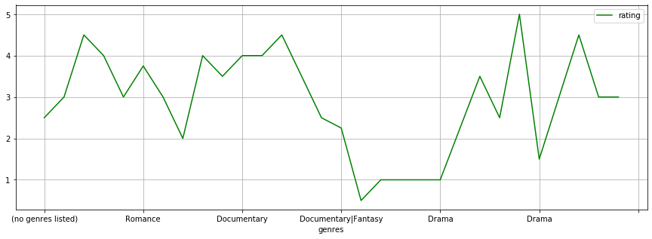
Findings (1)
We can visualize that drama genres are most in number and rated more than other movies genres.

Slide 9
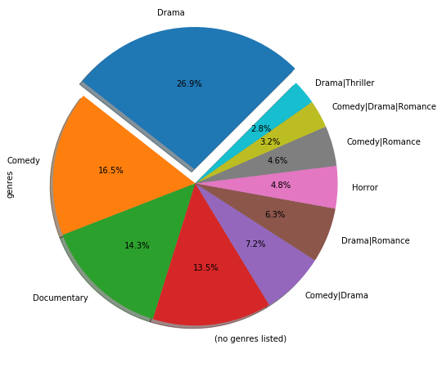
Findings (2)
Visualize in pie plot with percentile.

Slide 10
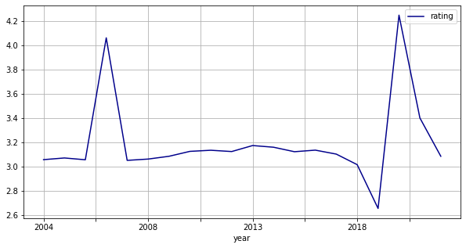
Findings (3)
Rating value of each movies with concern launching year. Also the average ratings of value in ratings columns.

Slide 11
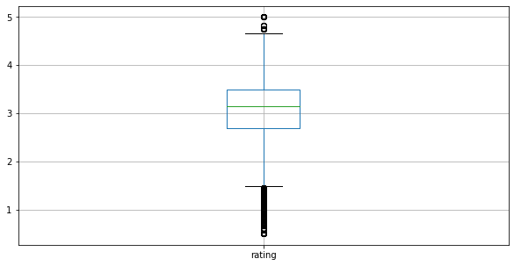
Findings (4)
In box plot we found.

Slide 12
Limitations
The whole dataset frequently updated so , new data generate every time and variation is obvious . To generate a predictive model we need more data to find out the hidder pattern of it to predict the model.

Slide 13
Conclusions
The whole dataset frequently updated so , new data generate every time and variation is obvious . To generate a predictive model we need more data to find out the hidder pattern of it to predict the model.

Slide 14
Acknowledgements
We are using the following dataset : IMDB Movie Dataset http://grouplens.org/datasets/ .
And yes , I used some other informal analysis to inform my work. Taking about feedback , unfortunately I don’t have no one to get feedback from now.

Slide 15
References
http://grouplens.org/datasets/
http://pandas.pydata.org/pandas-docs/stable

